Slide 1
Designing circuit diagram and schematics for receiver side
Sagar Pasricha (C0765531)
Notes:
1

Slide 2
Different Software's used for circuit designing
Circuit Maker
Microsoft Visio
Easy EDA
Fritzing
Eagle
OrCAD
gEDA
SmartDraw
KiCad
CircuitLab
XCircuit

Slide 3
Easy EDA
Easy EDA is a web based EDA tool that enables the hardware engineers to design, simulate, share and discuss schematics, simulations and printed circuit boards. Features may include Bill of Materials, Gerber files and pick and place files and documentary outputs in PDF, PNG and SVG formats.
Most of the things, such as libraries, projects, custom-made parts, packages and shared files are accessible via a simple drop down menu at the top left side of the software interface. This makes it easy for you to navigate through the software regardless of whether you are beginner or pro.

Slide 4
Beaglebone black wireless
Based on the extremely successful open-source BeagleBone Black hardware design, BeagleBone Black Wireless is a high-expansion, maker-focused, community-supported open hardware computer created by the BeagleBoard.org Foundation.
512MB DDR3 RAM
4GB 8-bit eMMC on-board flash storage
3D graphics accelerator
NEON floating-point accelerator
2x PRU 32-bit microcontroller

Slide 5
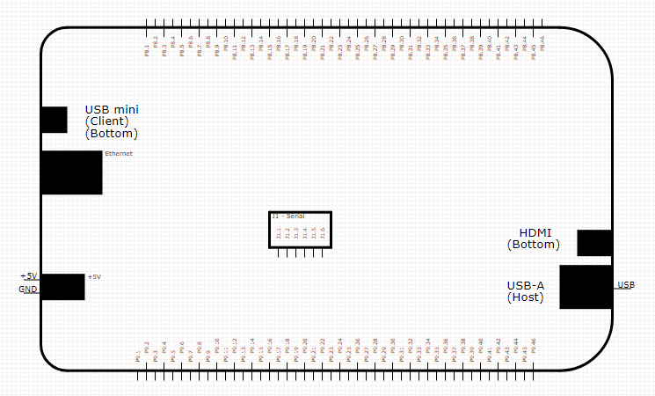
Beaglebone black wireless

Slide 6
Buzzer interfacing
For interfacing buzzer, GPIO pins of BBB are used.
A buzzer or beeper is an audio signaling device, which may be mechanical, electromechanical, or piezoelectric. Typical uses of buzzers and beepers include alarm devices, timers and confirmation of user input such as a mouse click or keystroke.

Slide 7
Buzzer interfacing
BBB | Buzzer
1 (DGND) | -V
23 (GPIO_49) | +V

Slide 8
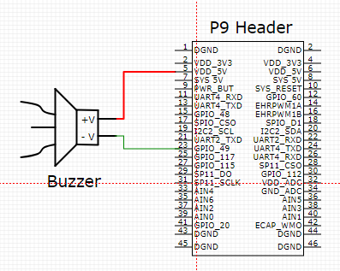
Buzzer interfacing

Slide 9
Gas & SMOKE sensor interfacing
SPI or I2C protocol can be used to interface LPG sensor via GPIO pins of BBB. There is possible schematics where the gas sensor is connected to 5V power supply at a BeagleBone Black's analog input pin.

Slide 10
Gas & SMOKE sensor interfacing
BBB | MQ2 Sensor
1 (DGND) | GND
5 (VDD 5V) | Vcc
33 (AIN4) | Vout

Slide 11
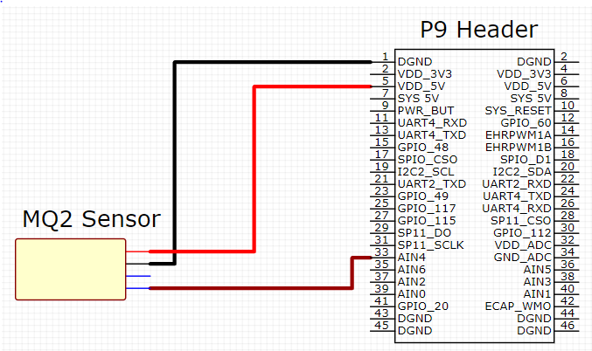
Gas & SMOKE sensor interfacing

Slide 12
GAS & smoke sensor interfacing
BBB | MQ6 Sensor
2 (DGND) | GND
6 (VDD 5V) | Vcc
36 (AIN5) | Vout

Slide 13
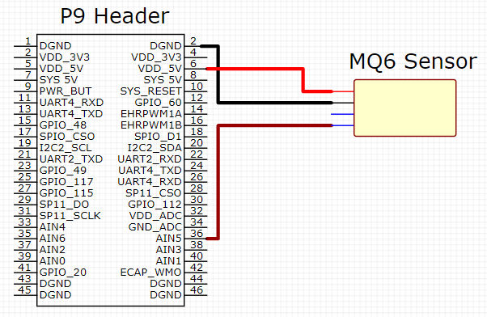
GAS & smoke sensor interfacing

Slide 14
temperature sensor
interfacing
LM35 is an analog sensor (Temperature Sensor) which measures the temperature and linear output given in voltage form. ADC is required to convert analog output of temperature sensor to digital output. Since BBB has an on chip ADC, we can directly interface these two.

Slide 15
temperature sensor
interfacing
BBB | LM35 Sensor
1 (DGND) | GND
5 (VDD +5V) | Vcc
38 (AIN3) | Vout

Slide 16
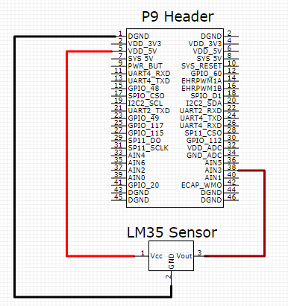
temperature sensor
interfacing

Slide 17
dc fan interfacing
One of the GPIO pin of BBB is connected to the Opto-coupler’s photodiode pin which lets the inner circuit to switch on (closed circuit) and we can connect the other end to the Fan.

Slide 18
dc fan interfacing
BBB | Optocoupler | DC Fan
15 (GPIO_48) | 1 (Photodiode)
45 (DGND) | 2 (Photodiode)
 | 4 (Vout) | Red
 | 5 (+9V)

Slide 19
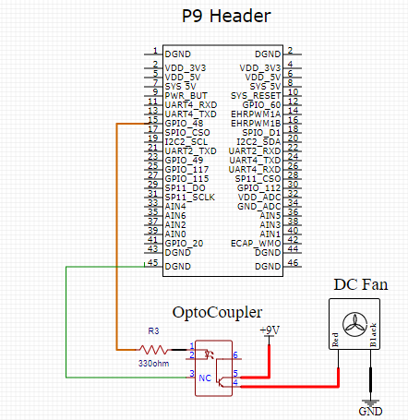
dc fan interfacing

Slide 20
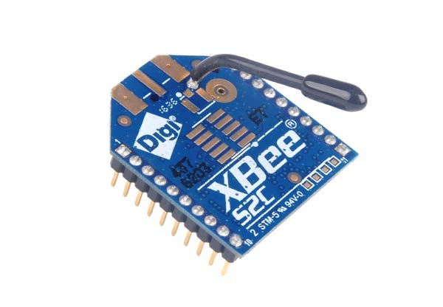
Xbee interfacing
For a microcontroller based project, communication is necessary between devices. In our project we need two-way communication, so we use XBee trans-receiver which can transmit and receive data at the same time.

Slide 21
Xbee interfacing
Pin Interface with Beaglebone Balck Wireless:
BBB | XBee
6 (Vdd +5V) | 1 (Vcc)
22 (UART_RxD) | 2 (Dout)
24 (UART4_TxD | 3 (Din)
46 (DGND) | 10 (GND)

Slide 22
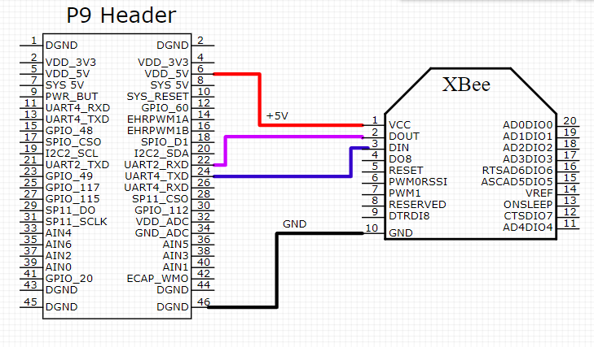
Xbee interfacing

Slide 23
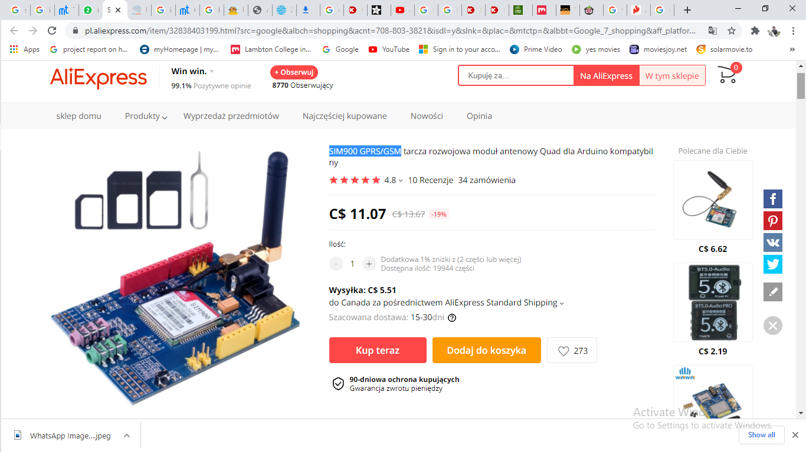
Gsm module interfacing
The SIM900 is a complete Quad-band GSM/GPRS solution in a SMT module which can be embedded in the customer applications. Featuring an industry standard interface, the SIM900 delivers GSM/GPRS 850/900/1800/1900MHz performance for voice, SMS, data and fax.
SIM900 is designed with a very powerful single-chip processor integrating AMR926EJ-S core
We have interfaced GSM module to Beaglebone via Arduino.

Slide 24
Gsm module interfacing with arduino
Arduino | GSM Module
D_0 | TX (Transmitter)
D_1 | Rx (Receiver)
GND2 | GND
5V | 5V

Slide 25
Arduino interfacing with Beaglebone:
Arduino | Beaglebone
D_6 | 26(UART_4RXD)
D_7 | 24(UART_4TXD
GND2 | GND
5V | 5V

Slide 26
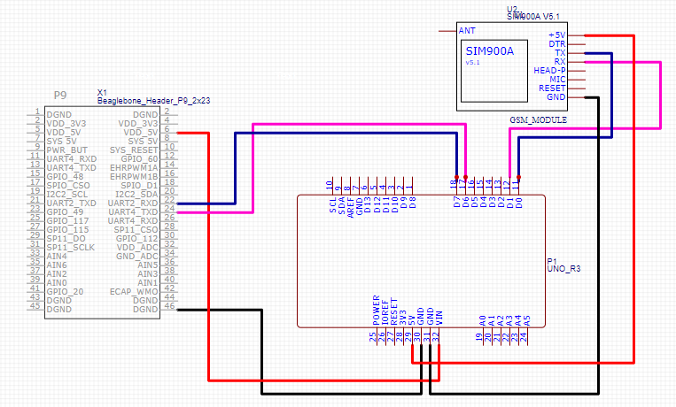
Gsm module interfacing

Slide 27
I2c lcd interfacing
LCD (Liquid Crystal Display), In order to interface BBB to LCD ,GPIO pins of Beaglebone are used. Before installing the character LCD library you'll need to make sure a few dependencies are installed On the BeagleBone Black.
Firstly, we need to interface I2C module with Beaglebone Black wireless including supply voltage.
Then LCD is connected to I2C module including supply and data pins.

Slide 28
I2c lcd interfacing
BBB | I2C Module
2 (DGND) | 17 (GND)
6 (Vdd +5V) | 18 (Vcc)
19 (I2C2_SCL) | 19 (SDA)
20 (I2C2_SDA) | 20 (SCL)

Slide 29
I2c lcd interfacing
I2C Module | LCD
1 (VSS) | 1 (VSS)
2 (VDD) | 2 (VDD)
3 (V0) | 3 (V0)
4 (RS) | 4 (RS)
5 (R/W) | 5 (R/W)
6 (E) | 6 (E)
7-14 (DB0-DB7) | 7-14 (DB0-DB7)
15 (A) | 15 (BLA)
16 (K) | 16 (BLK)

Slide 30
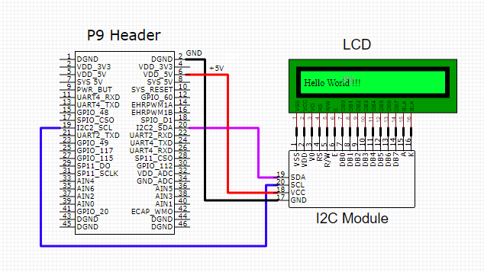
I2c lcd interfacing

Slide 31
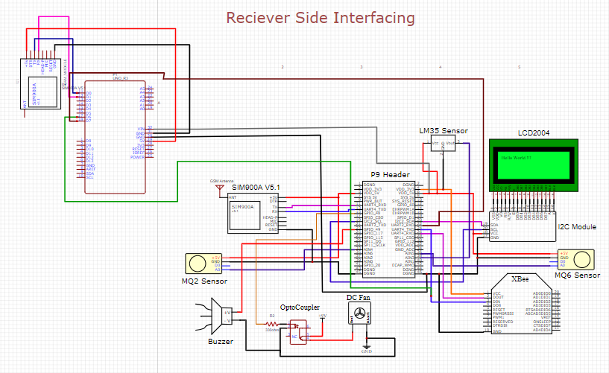
Receiver circuit

Slide 32
references
EasyEDA tutorial. Retrieved from easyeda.com: https://docs.easyeda.com/en/FAQ/Editor/index.html
turn on-off a 12V cpu fan with optocoupler. (n.d.). Retrieved from stackexchange.com: https://electronics.stackexchange.com/questions/154119/arduino-turn-on-off-a-12v-cpu-fan-with-optocoupler
MQ2 Gas Sensor. (2018, jan 04). Retrieved from components101.com: https://components101.com/mq2-gas-sensor
DiCola, T. (n.d.). Character LCD with Raspberry Pi or BeagleBone Black. Retrieved from www.digikey.ca: https://www.digikey.ca/en/maker/projects/character-lcd-with-raspberry-pi-or-beaglebone-black/3990178769cf4d2293f1a19993873f05
Interfacing to the Beagle Board optocoupler Input/Outputs. (n.d.). Retrieved from exploringbeaglebone.com: http://exploringbeaglebone.com/chapter6/
Measure Temperature using LM35 Interfacing with Beaglebone black. (n.d.). Retrieved from engineersgarage.com: https://www.engineersgarage.com/electronic-projects/measure-temperature-using-lm35-interfacing-with-beaglebone-black-part-15-15/
XBee S2C ZigBee (Wire Antenna). (n.d.). Retrieved from elediy.com: https://elediy.com/products/xbee-s2c-zigbee-wire-antenna
Zigbee Wireless Mesh Networking. (n.d.). Retrieved from www.digi.com: https://www.digi.com/solutions/by-technology/zigbee-wireless-standard
GSM Module Interfacing. (n.d.). Retrieved from rhydolabz.com: https://www.rhydolabz.com/wiki/?p=10450

Slide 33
Any questions?

Slide 34
Thank you

